Slide 1
Engaging employers in the domestic abuse agenda
1

Slide 2
Agenda
1
2
3
4
5
6
7
8
About
us
What is domestic abuse?
Why we exist
Why we work directly with employers
Why join?
Our Membership Charter
The resources we offer
Ways to get involved
2

Slide 3
Domestic abuse. It’s all our business.
3

Slide 4
About us
We are a growing network of employers that come from a wide variety of sectors, working collectively to take action on domestic abuse.
We are constantly evolving, collating feedback and learning from our initiatives.
We are committed to change. We help employers better care for their employees by implementing effective internal policies on domestic abuse.
We offer easily accessible practical support and tools, through information, meetings and digital resources.
4

Slide 5
What is domestic abuse?
Domestic abuse can take many forms, and if we are to achieve our vision of every employer taking action on domestic abuse, it is important that it is first properly recognised and understood:
Domestic abuse is complex
Domestic abuse does not only occur between couples.
Domestic abuse is not gender-specific.
Domestic abuse can take many forms
Domestic abuse involves many different acts and behaviours
Source: Vodafone Foundation’s Domestic Violence and Abuse presentation
5

Slide 6
Why we exist
6

Slide 7
Why we work with employers
Only through greater awareness, relationship building and the sharing of best practice can we make a systematic change to the way domestic abuse is thought about and handled in the UK. We believe that every employer plays an important part in that.
When employers demonstrate that they are aware of domestic abuse and make staff aware of the services that are available, this can help to reduce the wall of silence about domestic abuse that prevents many from seeking help.
7

Slide 8
Why join?
1
For your employees
2
For your business
3
For society
There is significant stigma surrounding domestic abuse, and people don't find it easy to seek out support. Help employees affected by domestic abuse, stop perpetrators and create a better business environment for all.
The cost of domestic abuse to business is estimated at £1.9bn due to decreased productivity, time off work, lost wages and sick pay. Share lessons and resources, attend our regular events, and influence the national domestic abuse agenda – it makes economic sense.
Two women are killed by a partner, or ex-partner, every week in England and Wales. Police receive 100 calls an hour relating to domestic abuse. The scale of the problem demands that every part of our society rise to this challenge, and we want businesses to play their part.
8

Slide 9
Our Membership Charter
We will…
Our members will…
Work to help every employer take action on domestic abuse by:
Raising awareness about the role of employers in stopping domestic abuse.
Equipping businesses with the tools they need to care for employees affected by domestic abuse.
Connecting our members to the right partners and initiatives for support and shared learning.
Leveraging the voice of our members in campaigns to influence domestic abuse UK policy.
Take action on domestic abuse by:
Demonstrating awareness of domestic abuse and breaking the wall of silence in the workplace.
Supporting employees affected by domestic abuse and providing access to or information about services.
Providing education and support to help perpetrators of domestic abuse to stop.
Sharing best practice with other members.
9

Slide 10
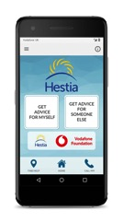
The resources we offer
Bright Sky mobile app
Everyone’s Business
Toolkit for Employers
Bright Sky is a free to download mobile app, launched in a partnership between Hestia and the Vodafone Foundation.
It provides support and information to anyone who may be experiencing domestic abuse, or is concerned about someone they know.
hestia.org/brightsky
Everyone’s Business puts employers at the heart of tackling domestic abuse.
It provides the tools needed to recognise and prevent domestic abuse, be prepared to receive disclosures and actively respond and speedily support employees who are experiencing or perpetrating domestic abuse.
hestia.org/everyonesbusiness
Preventing and tackling domestic abuse is an integral part of providing a safe and effective work environment, helping employers to deliver their duty of care.
This toolkit offers employers guidance and support and consolidates the best evidence and employer practice.
eida.org.uk/toolkit-for-employers
10

Slide 11
Ways to get involved: Membership benefits
1
2
3
Regular events, including our annual conference and quarterly network meetings, where you will receive updates from influential speakers and have the opportunity to network with other members.
A wide selection of resources, which includes the Toolkit for Employers, Everyone’s Business initiative, and shared lessons on practice from other members.
Conversations on the national domestic abuse agenda through our policy work on the Domestic Abuse Bill.
11

Slide 12
Ways to get involved: Membership activities
Grow the network
Hold, share or develop information about where members can get help
Strengthen internal practice
Encourage other employers, large and small, to join us.
Provide us with introductions to other employers.
Attend our events, including our quarterly network meetings and our annual conference.
Develop a policy on domestic abuse for staff.
Train managers, staff and ambassadors on domestic abuse.
Encourage members of staff experiencing abuse to seek help and provide them with support, including time off.
Signpost employees to the Bright Sky mobile app.
Put information on their website and intranet about domestic abuse.
Include information in graduate and apprenticeship inductions.
12

Slide 13
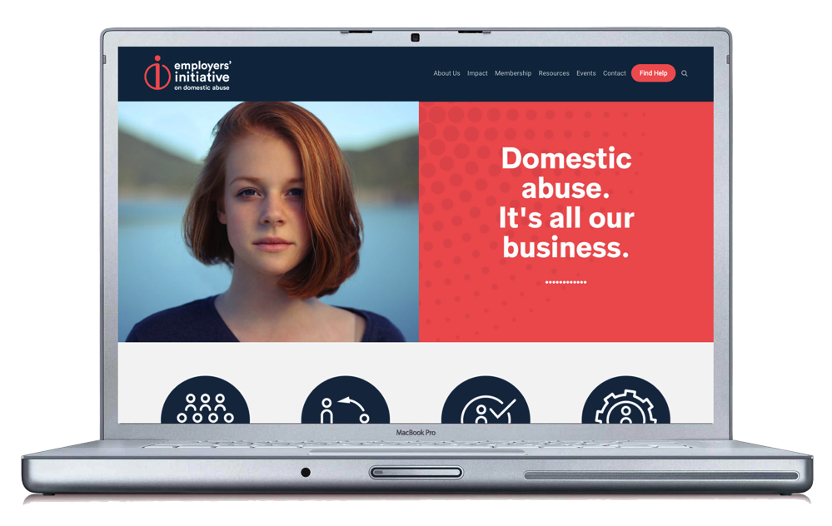
Find out more
Our website is packed with further information, including material on how to become a new member.
You can find out more, or ask us any questions, by visiting:
eida.org.uk
13

Slide 14
Thank you

